Slide 1


HPRC and MathWorks Present: Deep Learning Onramp

Slide 2
Today:
6:15 pm – 6.30 pm: Set-up
Intro to Deep Learning
Create MathWorks account
Log in to Deep Learning Onramp / Test MATLAB Online
6.30 pm – 8.00 pm: Deep Learning Onramp (on your own)

Slide 3
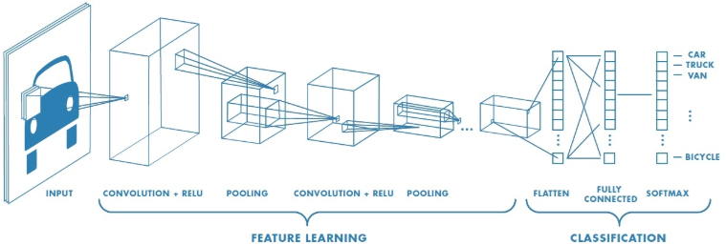
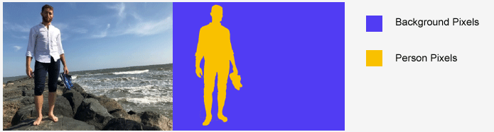
What is Deep Learning?
Machine learning in which a model learns to perform classification tasks
Implemented using a neural network architecture
Deep refers to the number of layers in the network
Deep learning at work:
A self-driving vehicle slows down as it approaches a pedestrian crosswalk
An ATM rejects a counterfeit bank note
A smartphone app gives an instant translation of a foreign street sign

Slide 4
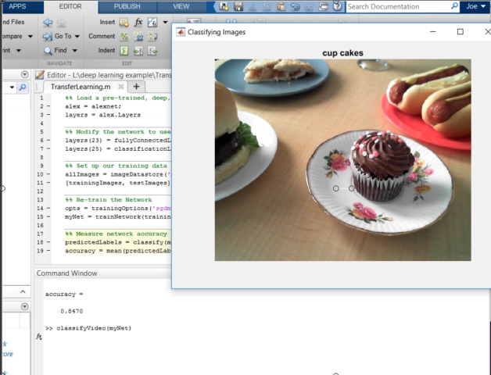
Using MATLAB with Deep Learning
With just a few lines of MATLAB code, you can build deep learning models without having to be an expert
MATLAB is fast: Run deployed models up to 7x faster than TensorFlow
Easily access the latest models, including GoogLeNet, VGG-16, AlexNet and much more

Slide 5
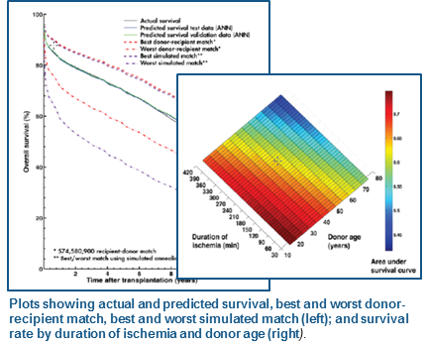
Lund University Develops an Artificial Neural Network for Matching Heart Transplant Donors with Recipients
Challenge Improve long-term survival rates for heart transplant recipients by identifying optimal recipient and donor matches
Solution Use MathWorks tools to develop a predictive artificial neural network model and simulate thousands of risk-profile combinations on a 56-processor computing cluster
Results
Prospective five-year survival rate raised by up to 10%
Network training time reduced by more than two-thirds
Simulation time cut from weeks to days
“I spend a lot of time in the clinic, and don’t have the time or the technical expertise to learn, configure, and maintain software. MATLAB makes it easy for physicians like me to get work done and produce meaningful results.”
- Dr. Johan Nilsson, Skåne University Hospital, Lund University
Link to user story
Notes:
Primary Industry: Biotech and Pharmaceutical
Secondary Industries: Academia
Product Capabilities: Data Analysis, Mathematical Modeling, Parallel Computing
Applications: Computational Biology
Products Used: MATLAB, MATLAB Distributed Computing Server, Neural Network Toolbox, Parallel Computing Toolbox
Country: Sweden
Lund University Develops an Artificial Neural Network for Matching Heart Transplant Donors with Recipients
A heart transplant recipient’s survival depends on dozens of variables, including the weight, gender, age, and blood type of both donor and recipient, and the ischemic time— or the time during a transplant when there is no blood flow to the organ.
To better understand transplant risk factors and improve patient outcomes, researchers at Lund University and Skåne University Hospital in Sweden use artificial neural networks (ANNs) to explore the complex nonlinear relationships among multiple variables. The ANN models are trained using donor and recipient data obtained from two global databases: the International Society for Heart and Lung Transplantation (ISHLT) registry and the Nordic Thoracic Transplantation Database (NTTD). The Lund researchers accelerated the training and simulation of their ANNs by using MATLAB, Neural Network Toolbox, and MathWorks parallel computing products.
“Many of the techniques we use are computer-intensive and time-consuming,” says Dr. Johan Nilsson, Associate Professor in the Division of Cardiothoracic Surgery at Lund University. “We used Parallel Computing Toolbox with MATLAB Distributed Computing Server to distribute the work on a 56-processor cluster. This enabled us to rapidly identify an optimal neural network configuration using MATLAB and Neural Network Toolbox, train the network using data from the transplantation databases, and then run simulations to analyze risk factors and survival rates.”
The Challenge
Understanding how various risk factors affect survival rates involved hundreds of thousands of computationally and data-intensive operations—for example, the team had to test hundreds of ANN configurations to identify the best one. An analysis of six variables requires the simulation of 30,000 different combinations. Simulating all these combinations for 50,000 patients took weeks using an open-source software package.
Nilsson and his colleagues encountered reliability problems with the software they were using, as well. “The software was unstable, which led to crashes during long, multiday simulations,” Nilsson explains. “In addition, some of the results it produced were not quite right. When we publish our findings, we need to be very sure we can trust the results.”
“I spend a lot of time in the clinic, and don’t have the time or the technical expertise to learn, configure, and maintain software. MATLAB makes it easy for physicians like me to get work done and produce meaningful results.”
- Dr. Johan Nilsson, Skåne University Hospital, Lund University
The Solution
To address the speed and reliability challenges, Lund University researchers developed their initial ANN model using MATLAB and Neural Network Toolbox. To find the optimal network configuration, they wrote MATLAB scripts that varied the number of hidden nodes used in the network for a range of weight decay (or regularization) values.
The team used Parallel Computing Toolbox and MATLAB Distributed Computing Server to accelerate the simulation of more than 200 ANN configurations. They then evaluated the results to find the best-performing configuration.
After training the ANN using donor and recipient information from the databases, they verified the model’s accuracy by simulating outcomes for 10,000 patients that had been omitted from the training set. They then compared the results against actual survival rates.
In the next phase, the team conducted thousands of simulations in parallel to rank the 57 risk factors considered in the study for predicting long-term survival.
Using results from Monte Carlo simulations on the computer cluster and simulated annealing techniques, the researchers identified the best and worst possible donors for any particular recipient.
As a final step, the team developed an automated process that ranks the recipient waiting list to identify the best candidates for a prospective donor.
In the next major phase of the project, Lund University researchers are using the ANN to investigate the use of Human Leukocyte Antigen (HLA) genetic profiles to match donors with recipients.
The Results
■ Prospective five-year survival rate raised by up to 10%. “In a simulated randomized trial, the preliminary results show that the ANN model we developed using MATLAB and Neural Network Toolbox would transplant approximately 20% more patients than would have been considered using traditional selection criteria,” says Nilsson. “The prospective five-year survival rate for the ANN-selected patients was 5–10% higher than those matched with the criteria physicians use today.”
■ Network training time reduced by more than two-thirds. “Using Neural Network Toolbox and MATLAB, it took us 5 to 10 minutes to train our ANNs,” says Nilsson. “Training took 30 to 60 minutes using open-source software. That is a big difference, because we were training and evaluating hundreds of network configurations.”
■ Simulation time cut from weeks to days. “When we switched to MATLAB and MathWorks parallel computing technologies, we completed experiments that regularly took 3 to 4 weeks in about 5 days,” says Nilsson. “More importantly, the simulations were completed reliably, with no crashes.”
Learn More About Lund University: www.lunduniversity.lu.se, www.med.lu.se/aicts
This project is a collaboration with:
• The Department of Clinical Sciences Lund at Lund University and Skåne University Hospital
• The Department of Astronomy and Theoretical Physics at Lund University
• The Competence Center of Clinical Research at Skåne University Hospital

Slide 6
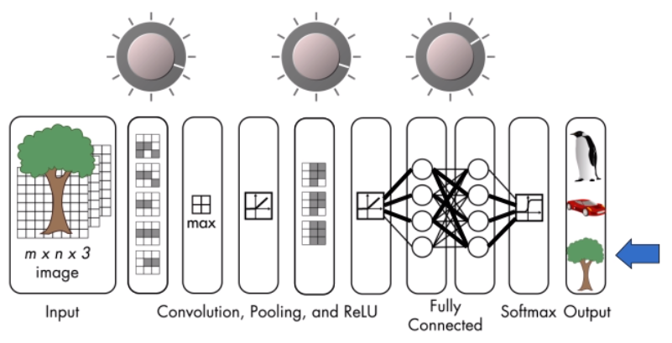
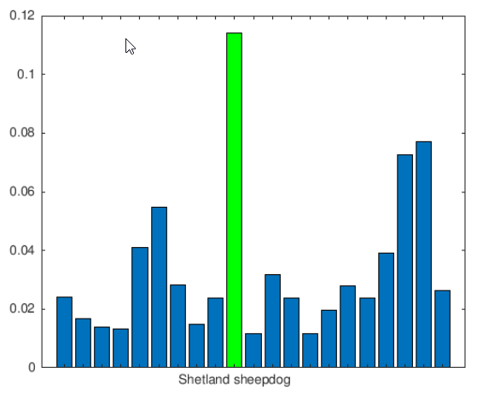
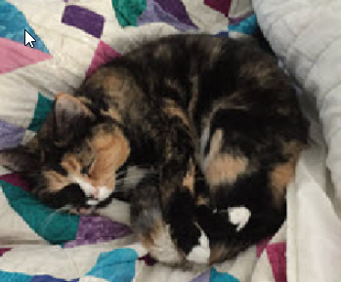
Deep Learning Onramp
Learn the basics of deep learning in 2 hours
Free access to everyone
Hands-on exercises and short video demonstrations
Work on real life image recognition problems
Topics include:
Convolutional neural networks
Working with pre-trained networks
Transfer learning
Evaluating network performance

Slide 7
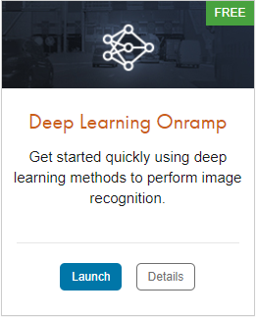
TO DO
Go to https://matlabacademy.mathworks.com/
Log in to your MathWorks account
Launch Deep Learning Onramp

Slide 8
Prizes
Complete at least 50% of Deep Learning Onramp to be eligible for any prize
Bring your laptop when you come to collect the prize
Follow Us on Facebook!
Find us on Facebook at [Insert Facebook Group Name]

